Slide 1
Computational Creativity: Making Music with AI Technologies
Erika Menezes, Serina Kaye
Cloud AI, Microsoft

Slide 2
Session Objectives
Computational creativity - Introduction
Data science process
Pre-processing
Model architecture
Experimentation Setup
Tools + Framework

Slide 3
Computational Creativity

Slide 4
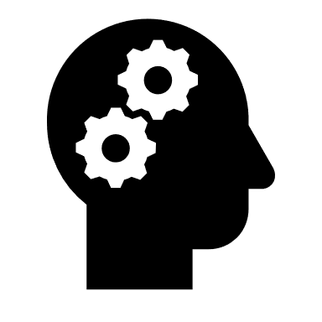
Why ?
$

Slide 5
History of Music Generation
1700s: Dice
Musikalisches Würfelspiel (1757)
1900s: Markov chains
Analogique (1958)
Emmy (Experiments in Musical Intelligence) (1980)
2000s: RNNs
Magenta (2016)
Startups​
Uberchord, HumOn, Skoog (Music Education)​
Popgun, Amper, AIVA, Jukedeck: (Commercial AI Music)​
Source: https://medium.com/artists-and-machine-intelligence/neural-nets-for-generating-music-f46dffac21c0

Slide 6
What ?
Melody – Single instrument (monophonic , polyphonic)
Polyphony – Multiple instruments
Accompaniment
AI Duet
Audio style transfer

Slide 7
Important Factors
Input Representation
Model Architecture
Dataset

Slide 8
System Overview
MIDI
Piano roll
Seq2Seq
Piano roll
MIDI

Slide 9
Music Formats
Music Formats
Source: http://qihqi.github.io/machine/learning/music-generation-using-rnn/

Slide 10
Music Theory 101
Beat:
basic unit of time (a.k.a quarter note)
Note:
pitch or frequency of note played, e.g. :60 = C5 = 261.625 Hz
Tempo:
beats per minute (BPM) = quarter notes per minute (QPM)
microseconds per quarter note (MPQN)

Slide 11
MIDI (Musical Instrument Digital Interface)
midi.Pattern(format=0, resolution=480, tracks=\
[midi.Track(\
[midi.SetTempoEvent(tick=0, data=[7, 161, 32]),
midi.NoteOnEvent(tick=0, channel=0, data=[60, 127]),
midi.NoteOnEvent(tick=0, channel=0, data=[64, 127]),
midi.NoteOnEvent(tick=0, channel=0, data=[67, 127]),
midi.NoteOffEvent(tick=100, channel=0, data=[60, 90]),
midi.NoteOffEvent(tick=0, channel=0, data=[64, 90]),
midi.NoteOffEvent(tick=0, channel=0, data=[67, 90]),
midi.EndOfTrackEvent(tick=1, data=[])])])

Slide 12
Piano Roll

Slide 13
MIDI (Musical Instrument Digital Interface)
midi.Pattern(format=0, resolution=480, tracks=\ #Resolution = 480 TPB
[midi.Track(\
[midi.SetTempoEvent(tick=0, data=[7, 161, 32]), #Tempo = 120 BPM = 2 BPS
midi.NoteOnEvent(tick=0, channel=0, data=[60, 127]),
midi.NoteOnEvent(tick=0, channel=0, data=[64, 127]),
midi.NoteOnEvent(tick=0, channel=0, data=[67, 127]),
midi.NoteOffEvent(tick=100, channel=0, data=[60, 90]),
midi.NoteOffEvent(tick=0, channel=0, data=[64, 90]),
midi.NoteOffEvent(tick=0, channel=0, data=[67, 90]),
midi.EndOfTrackEvent(tick=1, data=[])])])
Total ticks = 101
Time per time slice = 0.02s
Ticks per second = Resolution * Tempo = 480 * 2 = 960
Ticks per time slice = 960 * 0.02 = 19.2
Piano roll width = ceil (Total ticks / Ticks per time slice) = 6

Slide 14
MIDI (Musical Instrument Digital Interface)
midi.Pattern(format=0, resolution=480, tracks=\
[midi.Track(\
[midi.SetTempoEvent(tick=0, data=[7, 161, 32]),
midi.NoteOnEvent(tick=0, channel=0, data=[60, 127]), #Index = 0/19.2 => 0
midi.NoteOnEvent(tick=0, channel=0, data=[64, 127]), #Index = 0/19.2 => 0
midi.NoteOnEvent(tick=0, channel=0, data=[67, 127]), #Index = 0/19.2 => 0
midi.NoteOffEvent(tick=100, channel=0, data=[60, 90]), #Index = 100/19.2 => 5
midi.NoteOffEvent(tick=0, channel=0, data=[64, 90]), #Index = 100/19.2 => 5
midi.NoteOffEvent(tick=0, channel=0, data=[67, 90]), #Index = 100/19.2 => 5
midi.EndOfTrackEvent(tick=1, data=[])])])
Note | 0 | 1 | 2 | 3 | 4 | 5
60 (C5) | 1 | 1 | 1 | 1 | 1 | 0
62 (D5) | 0 | 0 | 0 | 0 | 0 | 0
64 (E5) | 1 | 1 | 1 | 1 | 1 | 0
65 (F5) | 0 | 0 | 0 | 0 | 0 | 0
67 (G5) | 1 | 1 | 1 | 1 | 1 | 0

Slide 15
Input Representation
Source: http://yoavz.com/music_rnn/

Slide 16
Datasets
Name | #songs | Format | License
Scale-chords | 156 | MIDI | Scale Chords License
Piano-midi.de (Classical) | 124 | MIDI | cc-by-sa Germany License
Nottingham (Folk) | 1000 | MIDI/ABC | GNU GPL v3
Yamaha e-Piano | 1400 | MIDI | Free
MusicNet | 330 | WAV | Creative Commons

Slide 17
System Overview
System Overview
MIDI
Piano roll
Seq2Seq
Piano roll
MIDI

Slide 18
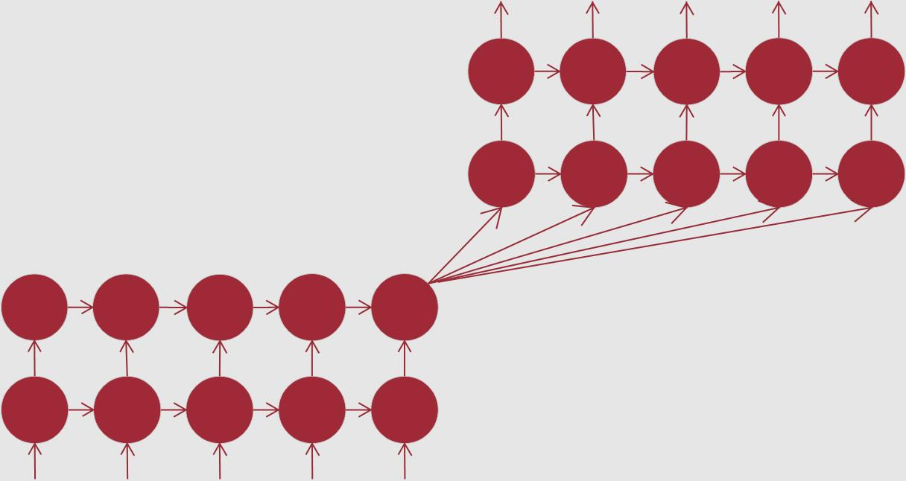
Model Architecture
1
0
…
0
0
1
1
…
1
1
0
0
…
0
0
1
0
…
0
0
0
0
…
0
1
LSTM:
Specialized RNN
Retains memory for longer sequences
Sequence to Sequence:
Encoder
Decoder
Different input and output lengths
Encoder
Decoder
1
0
…
1
0
0
1
…
1
0
0
0
…
0
0
1
1
…
0
1
0
1
…
1
1

Slide 19
Experimental Setup
Piano roll (156, note_len, T)
MIDI (156)
Input data (N, note_len, X_SEQ_LEN)
Target data (N, note_len, Y_SEQ_LEN)

Slide 20
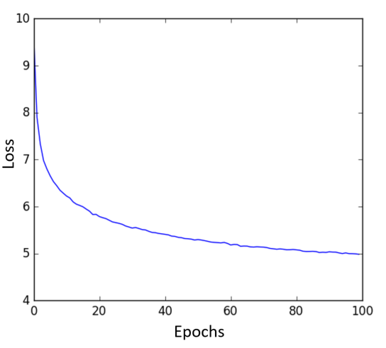
Training
Feed X_SEQ_LEN time steps of a piano roll
Predict Y_SEQ_LEN time steps following the X_SEQ_LEN time steps of a piano roll
Update the model weights using Adam optimizer
Repeat the process by sliding the time window X_SEQ_LEN time steps
The loss function (binary cross entropy) is defined as the negative log-likelihood of the model given the observed data.

Slide 21
Generation
Feed X_SEQ_LEN time steps of a piano roll
Predict Y_SEQ_LEN time steps following the X_SEQ_LEN time steps of a piano roll
Select the notes to be played using a threshold on output probabilities
Repeat the process by sliding the time window X_SEQ_LEN time steps

Slide 22
Demo
Erika Menezes

Slide 23
Azure Machine Learning Goals
trends
Solutions
Accelerating adoption of AI by industry and developers
Rise of hybrid training and scoring scenarios, especially those that push scoring/inference to the edge
Deep commitment to open-source tools and frameworks
Model management capabilities
Docker-based portability
Compute, framework and IDE agnosticism

Slide 24
Experiment Everywhere
Local machine
Command line tools
IDEs
Scale up to DSVM
Notebooks
AZURE ML
EXPERIMENTATION
VS Code Tools for AI
Scale out with Spark on HDInsight
Azure Batch AI
Azure service
Azure Databricks
Notebooks
IDEs
VS Code Tools for AI

Slide 25
Model Management & Deployment
Single node deployment (cloud/on-prem)
Azure Container Instance
Azure Machine Learning
DOCKER
Azure Managed Kubernetes Service
Azure IoT Edge
Azure service
Microsoft ML Server
CLI
VS Code Tools for AI
Spark clusters

Slide 26
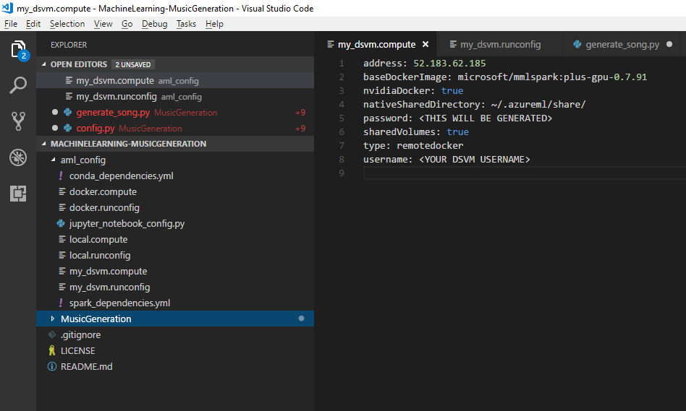
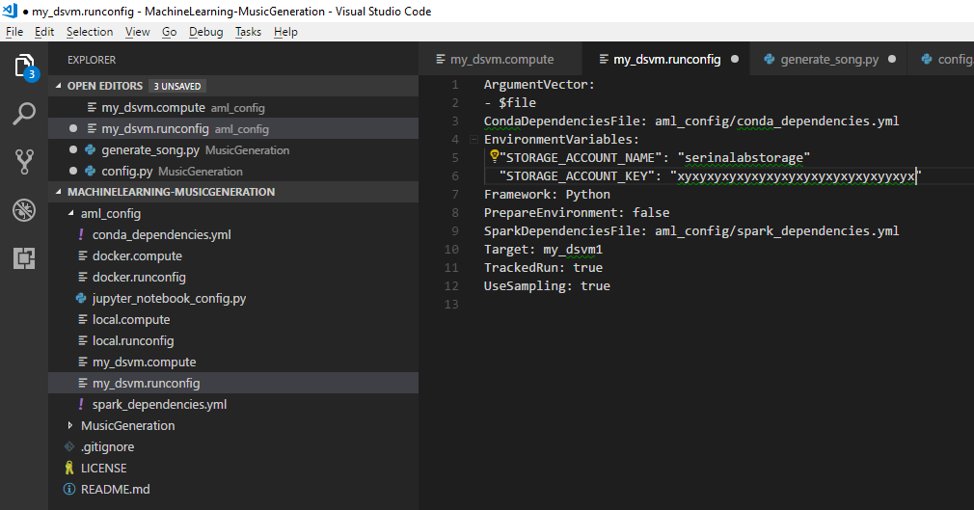
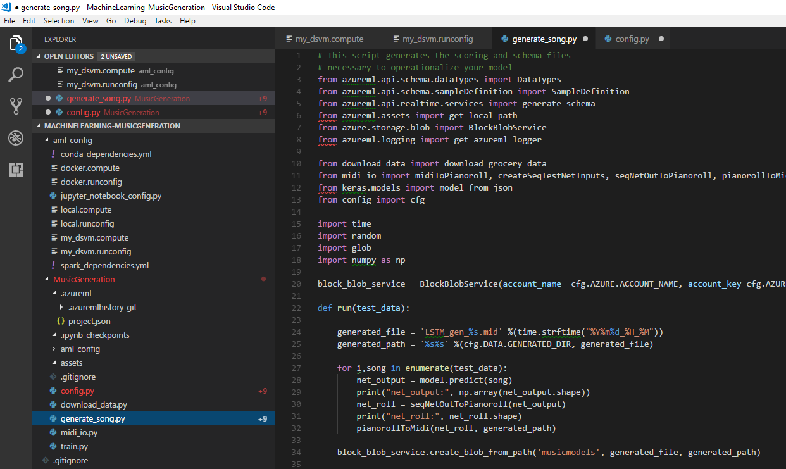
Music Generation on Azure
my_remote_vm.compute
Docker Hub
Base Docker Image
my_remote_vm.runconfig
Azure ML Execution Service
Remote VM
Docker Image Definition
Docker Engine
Execute Script
SSH
Erika’s program
Azure ML Run History Service
train.py
Runs
Metrics
Artifacts
Status
Run results and artifacts

Slide 27
Challenges
Generated music cannot infringe on copyrights
Good music is subjective
Hard to design a good loss function

Slide 28
Next Steps
Get a free Azure account: https://azure.microsoft.com/en-us/free
Get Azure Machine Learning: https://portal.azure.com
Code is available at: https://github.com/Azure/MachineLearning-MusicGeneration
Blog: https://aka.ms/Xsr88w

Slide 29
Questions?

